Slide 1
Classify between human vs AI translation
By Edward, Jose and Cindy

Slide 2

Project Overview
Given a dataset containing sentences in Spanish and their tags for AI or human translator. Our goal is to build a classifier that is able to distinguish between the two.

Slide 3


Approach
Analyze data check for particularities and quality of data.
Preprocessing Prepare data to be fed to models.
Experiment with a fan of models Naive Bayes,Logistic Regression, Linear SVM, N-grams, Transformer Models: BETO, RoBERTa-Spanish

Slide 4

Dataset
Total samples: ~18,000 texts
Class distribution: Balanced (50% human, 50% machine)
Text characteristics:
Extracted features: character length, word count, average word length, punctuation, uppercase letters, numbers
Language: Spanish

Slide 5
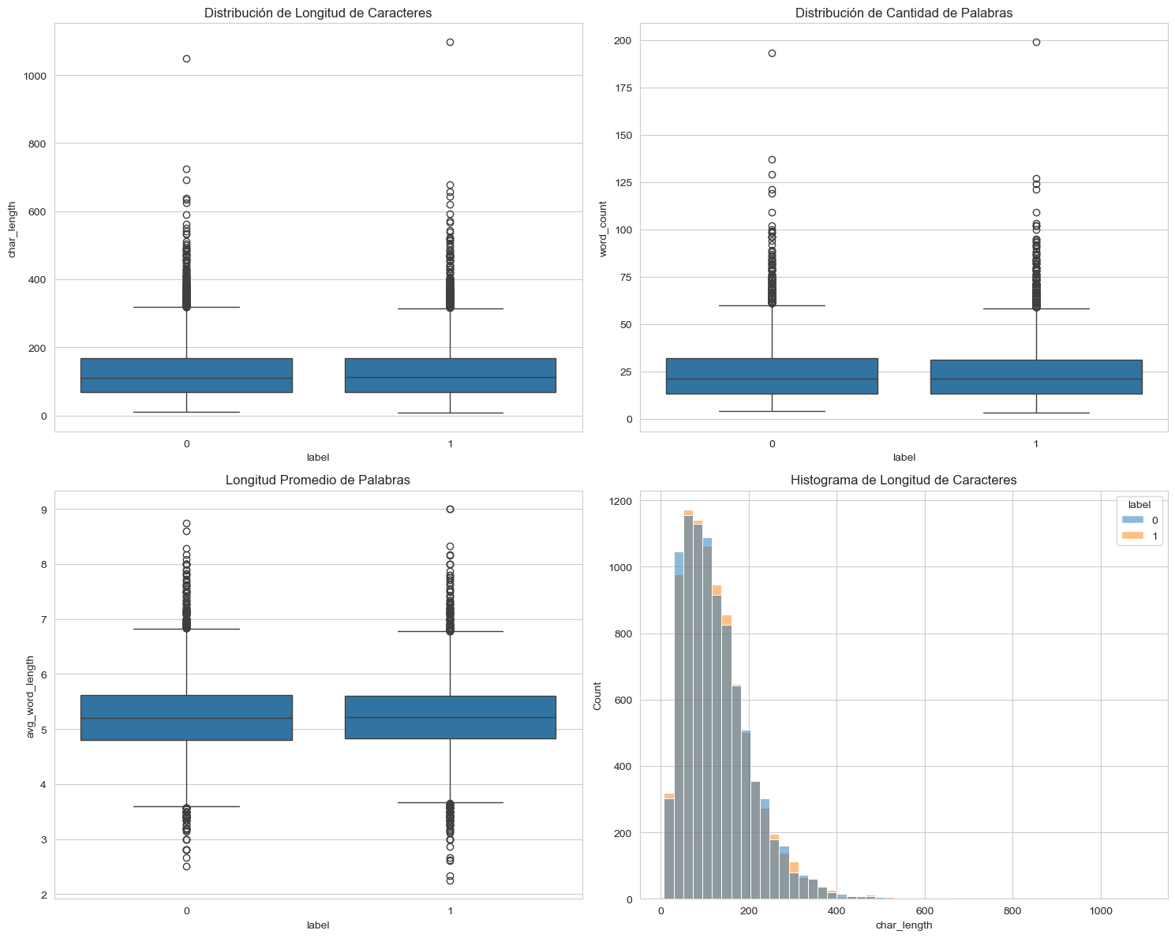
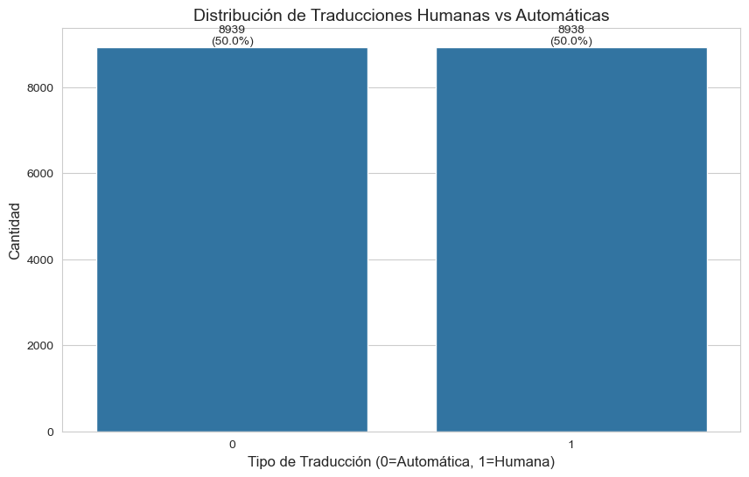
Data Analisis
Distributions
Tip
After checking the data we noticed that the quality of it was not good.

Slide 6
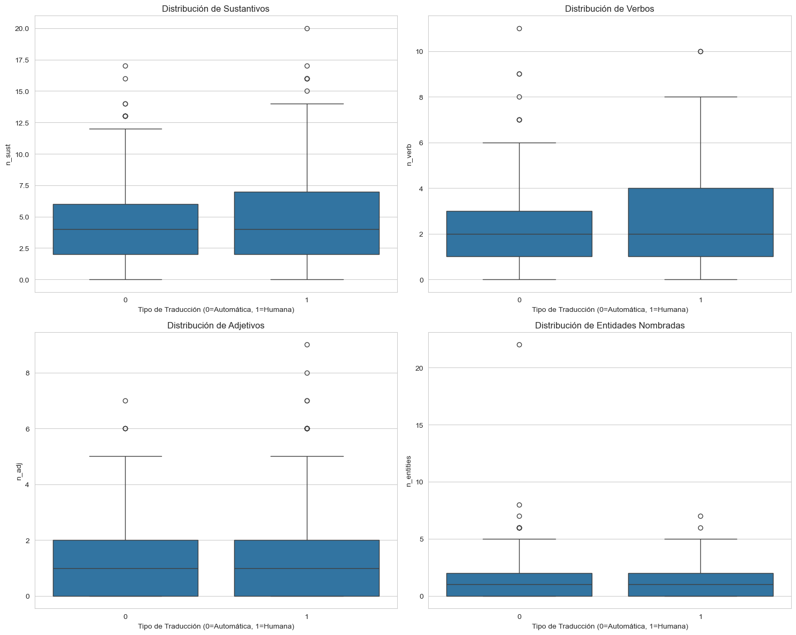
Data Analisis
Linguistic Analysis
Tip
After checking the data we noticed that the quality of it was not good.

Slide 7
Preprocessing
Space and punctuation normalization
Special characters removal
Lowercase conversion
Lemmatization using spaCy (es_core_news_md model)
Stopwords removal using NLTK

Slide 8
Classical Models
Naive Bayes
Model: MultinomialNB()
Vectorization: TF-IDF (max_features=5000)
Accuracy: 0.43
Confusion Matrix: [[798, 990], [1056, 732]]
Precision: 0.42
Recall: 0.42
F1-score: 0.42
Logistic Regression
LogisticRegression(max_iter=1000)
Vectorization: TF-IDF (max_features=5000)
Accuracy: 0.46
Confusion Matrix: [[841, 947], [983, 805]]
Precision: 0.46
Recall: 0.46
F1-score: 0.46
Linear SVM
LinearSVC(max_iter=1000)
Vectorization: TF-IDF (max_features=5000)
Accuracy: 0.44
Confusion Matrix: [[793, 995], [1011, 777]]
Precision: 0.44
Recall: 0.44
F1-score: 0.44

Slide 9
Transformer Models
BETO
Model: dccuchile/bert-base-spanish-wwm-uncased
Parameters:
Batch size: 32
Epochs: 5
Learning rate: 2e-5
Optimizer: AdamW
Max sequence length: 512
Accuracy: 0.592
Final average loss: 0.203
Confusion Matrix: [[981,770],[678,1147]]
RoBERTa-Spanish
Model: BSC-TeMU/roberta-base-bne
Parameters:
Batch size: 32
Epochs: 5
Learning rate: 2e-5
Optimizer: AdamW
Max sequence length: 512
Accuracy: 0.62
Final average loss: 0.13
Confusion Matrix: [[1158,593],[767,1058]]

Slide 10
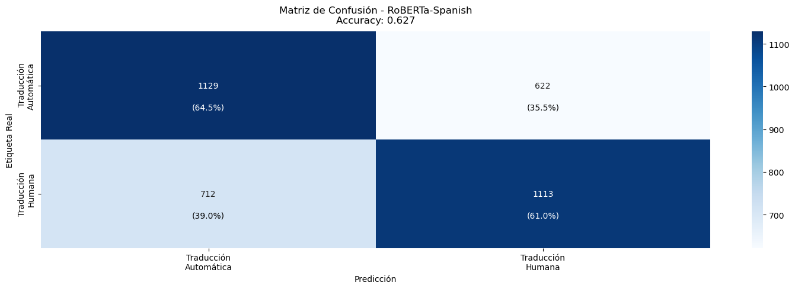
Conclusions
Transformer models (BETO and RoBERTa-Spanish) achieved the best results with accuracies of 0.592 and 0.62 respectively.
Among classical models, Logistic Regression performed best with an accuracy of 0.46.
N-grams analysis showed that bigrams were more effective (0.44) than unigrams (0.42) and trigrams (0.41).

